Slide 1
From Text to a Knowledge Graph: The Information Extraction Pipeline
Dr. Rakhee Chhibber
https://neo4j.com/blog/genai/text-to-knowledge-graph-information-extraction-pipeline/
https://github.com/SmartDataAnalytics/Knowledge-Graph-Analysis-Programming-Exercises
https://www.ibm.com/think/topics/graphrag

Slide 2
Introduction to knowledge Graph
Building an information extraction pipeline allows a developer to take these texts as inputs, process them with NLP (Natural Language Processing) techniques, and use the resulting structures to populate or enrich their knowledge graph. In this blog, I will explain how to build an information extraction pipeline to transform unstructured text inputs into a useful knowledge graph.

Slide 3
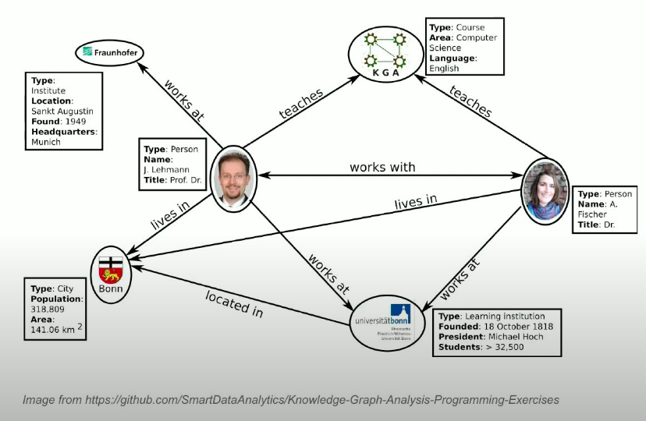

Slide 4
How It Work?
To begin, input text to the pipeline which can be from any PDFs or scraped from web pages, new slides, text files etc.
Input messages from your messaging platform into the information extraction pipeline.
A knowledge graph opens in new tabgraph has nodes that represent levels, entities, or concepts. There are many types of nodes, such as person, course, or city, and there are relationships between those nodes, such as located in, lives in, or works with. If you have a single relationship type, you are not yet dealing with a knowledge graph until you have more relationship types.

Slide 5
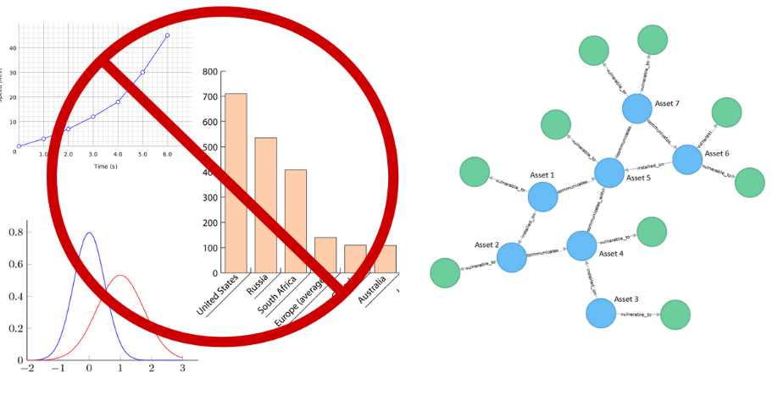

Slide 6
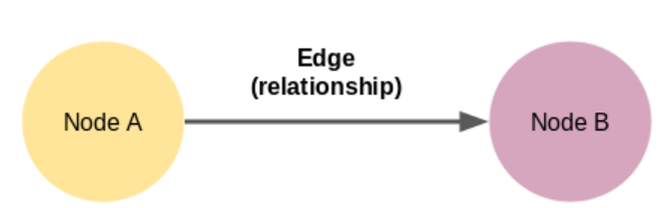
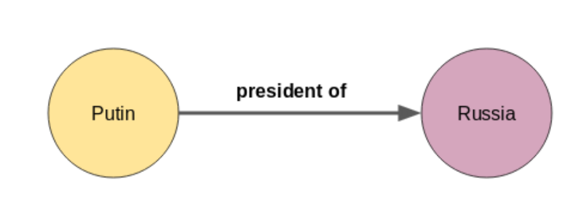
Knowledge Graph’s come in a variety of shapes and sizes. For example, the knowledge graph of Wikidata had 59,910,568 nodes by October 2019.

Slide 7
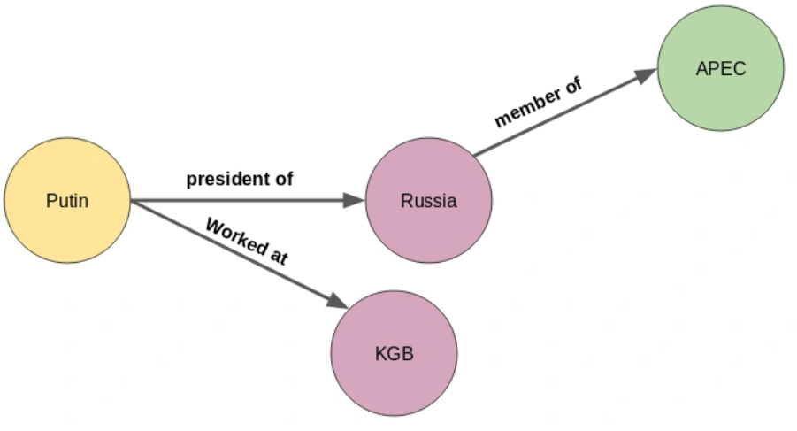
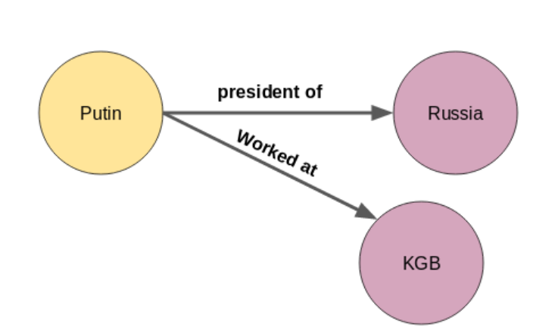
A node or an entity can have multiple relations as well.

Slide 8
Traditional NLP technique
using NLP techniques such as sentence segmentation, dependency parsing, parts of speech tagging, and entity recognition.
1. Sentence Segmentation
The first step in building a knowledge graph python is to split the text document or article into sentences. Then, we will shortlist only those sentences in which there is exactly 1 subject and 1 object. Let’s look at a sample text below:
“Indian tennis player Sumit Nagal moved up six places from 135 to a career-best 129 in the latest men’s singles ranking. The 22-year-old recently won the ATP Challenger tournament. He made his Grand Slam debut against Federer in the 2019 US Open. Nagal won the first set.”

Slide 9
Example of sentence segmentation
Indian tennis player Sumit Nagal moved up six places from 135 to a career-best 129 in the latest men’s singles ranking
The 22-year-old recently won the ATP Challenger tournament
He made his Grand Slam debut against Federer in the 2019 US Open
Nagal won the first set
Out of these four sentences, we will shortlist the second and the fourth sentences because each of them contains 1 subject and 1 object. In the second sentence, “22-year-old” is the subject and the object is “ATP Challenger tournament”. In the fourth sentence, the subject is “Nagal” and “first set” is the object:

Slide 10
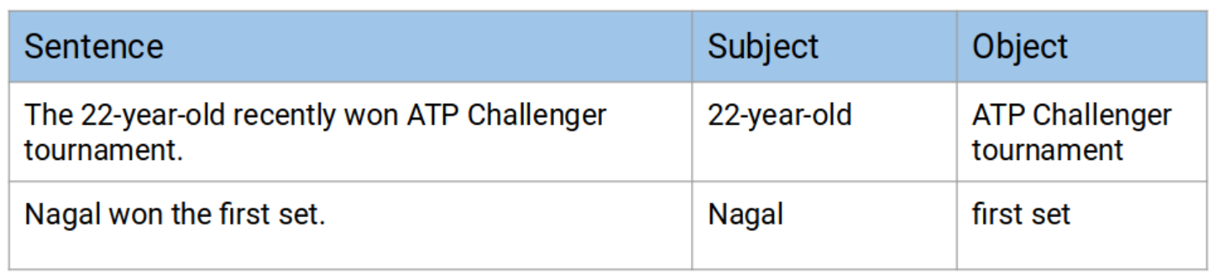

Slide 11
Entities Extraction
The extraction of a single word entity from a sentence is not a tough task. We can easily do this with the help of parts of speech (POS) tags. The nouns and the proper nouns would be our entities.
However, when an entity spans across multiple words, then POS tags alone are not sufficient. We need to parse the dependency tree of the sentence.

Slide 12
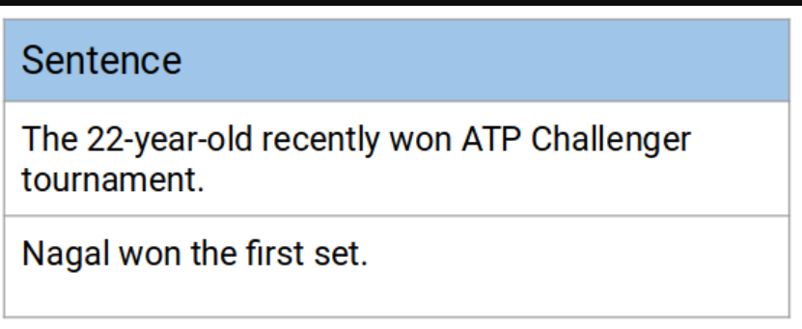
Extract Relations
To build a knowledge graph, we need edges to connect the nodes (entities) to one another. These edges are the relations between a pair of nodes.
Let’s go back to the example in the last section. We shortlisted a couple of sentences to build a knowledge graph python:

Slide 13
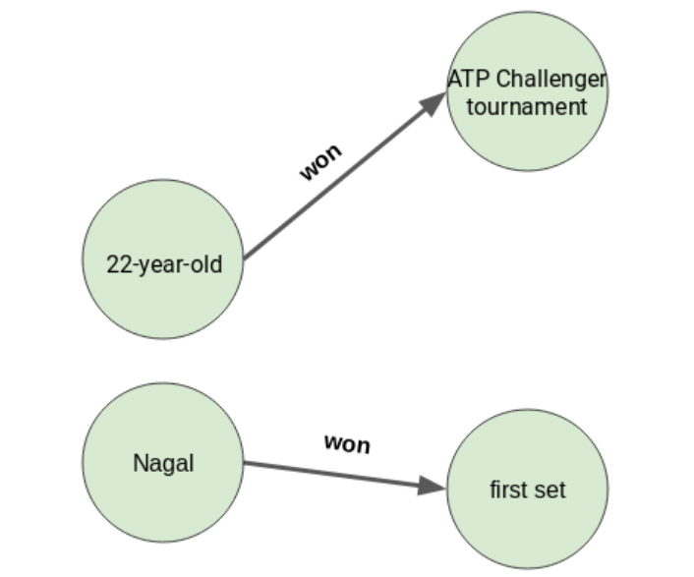

Slide 14
Entity Pairs Extraction
To build a knowledge graph, the most important things are the nodes and the edges between them.
These nodes are going to be the entities that are present in the Wikipedia sentences. Edges are the relationships connecting these entities to one another. We will extract these elements in an unsupervised manner, i.e., we will use the grammar of the sentences.
The main idea is to go through a sentence and extract the subject and the object as and when they are encountered. However, there are a few challenges ⁠— an entity can span across multiple words, eg., “red wine”, and the dependency parsers tag only the individual words as subjects or objects.

Slide 15
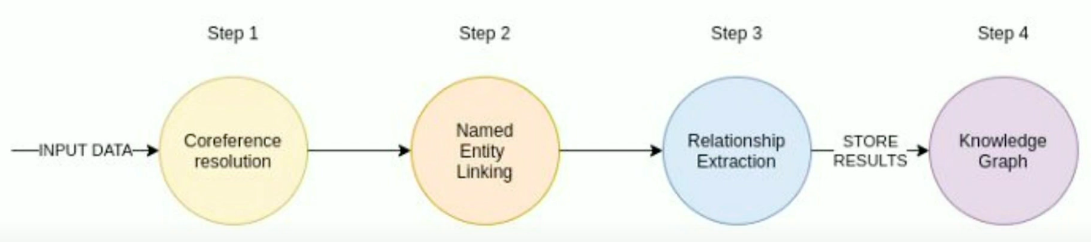
4-Step Pipeline

Slide 16
Information extraction pipeline consists of four steps.
The first three steps are NLP techniques, and then we store the results of the NLP techniques into a opens in new tabgraph database.
Constructing a knowledge graph is important because there is a wealth of information generated every day. Businesses have emails or PDFs with large amounts of text generated in addition to relevant texts available on the internet, including photos and scrape pages. In the future, information extraction pipelines will become more and more relevant.

Slide 17
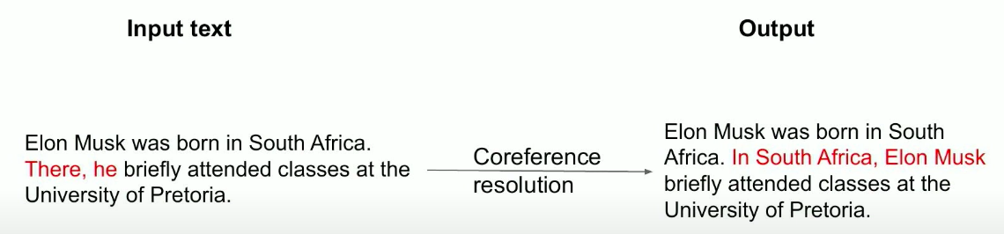
Step 1: Coreference Resolution
The first step is the coreference resolution, which is an NLP language technique that finds all expressions that refer to the same entity in a text. It finds all the pronouns and then replaces those with their reference entities. Pronouns can be personal, location, or possessive. Here’s a simple example.

Slide 18
explaination
Elon Musk was born in South Africa. There, he briefly attended classes at the University of Pretoria. You can see that the first sentence doesn’t have any pronouns, but the second sentence has two pronouns, one locational and one personal. The ideal result of the coreference resolution model would be an output that replaces There with South Africa and replaces he with Elon Musk. We end up with: In South Africa, Elon Musk briefly attended classes at the University of Pretoria.
This might seem really basic, but real-world examples of coreference resolution could get quite complicated. Plus, it is a very important step in the information extraction pipeline.

Slide 19
Step 2: Named Entity Recognition
Once we’ve dealt with the coreference resolution, we move on to named entity recognition, which is a task for recognizing all the mentioned entities in the text. Those entities could be of various types; for example, we could have a person, location, or geopolitical entity.
We also have organizational entities, which will find the entities that the NLP model is trained on. The training data really depends on the domain or the intended obligations that you’re using your information extraction pipeline for. There are a couple of limitations for named entity recognition. I will just point out the most obvious with the example I’ve shown using Elon Musk in three different sentences.

Slide 20
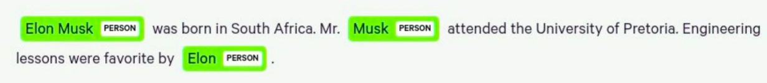
The first sentence uses Elon Musk’s full name, and the second time, he’s mentioned as Mr. Musk. In the third sentence, he’s mentioned as Elon. In an output knowledge graph, we ideally want a single real-world entity to be represented with a single node. We really don’t want to have three different nodes representing the same entity as you would have here. Remember, the named entity recognition order depends on the domain of the intended application. Most of today’s open-sourced models are based on different types of texts. For example, if you wanted to analyze biomedical text and extract biomedical concepts, like genes, drugs, or diseases, then you would need to use a different NLP model that was trained to extract biomedical concepts.
No model is 100% accurate. Even when I was preparing this example, if in the third sentence, I started the sentence with Elon to say Elon’s favorite lessons were engineering, then Elon was not recognized as a person in the spacing model.

Slide 21
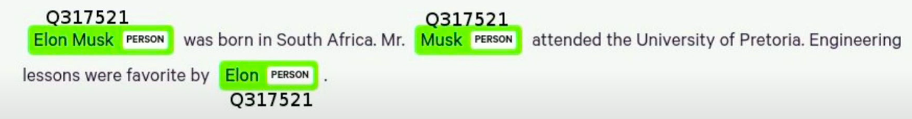
Entity Disambiguation and Entity Linking
How could we solve the entity disambiguation so that a single real-world entity would be represented as a single node in a knowledge graph? The answer is entity linking. To go from name entity recognition to name entity linking means that we aggregate the name entity recognition to first recognize all the entities, and then map those entities to a target knowledge base. Very frequently, that target knowledge base is Wikipedia. In essence, you recognize the name entity linking model as entities in the text, and then link them to a Wikipedia ID.

Slide 22
Here you can see that I’ve added Wikipedia ID for all the entities. Ideally, the result would be that even though we have three different titles of texts for Elon Musk, they would all link to the same entity on Wikipedia. We could use that Wikipedia ID as identities for nodes in our knowledge graph, and we would end up with a single node in our knowledge graph.
This process is so common that linking entities to Wikipedia is actually called “wikification”. The plus side is we don’t have to worry about which text record is correct because here we have three different text records that refer to the same entity. We could just use the Wikipedia ID and then use the different texts and names, and link them all back to the entity name on Wikipedia.
Whilst we have Wikipedia IDs for the entities, we can also use Wikipedia to enrich our knowledge graph. You could combine the information that you get from the information extraction pipeline with online information available on Wikipedia, and use that to create a more full knowledge graph, starting with NLP techniques. Some of you might say that Wikipedia is not the most accurate source, but Google uses Wikipedia extensively. So I say, if it’s good enough for Google, it’s good enough for me.

Slide 23
Knowledge Grpah using Traditional NLP Approach (spaCy + NetworkX).ipynb
Knowledge graph of wikipedia.ipynb
llmgraph_example.ipynb
https://www.analyticsvidhya.com/blog/2019/10/how-to-build-knowledge-graph-text-using-spacy/
https://github.com/dylanhogg/llmgraph

Slide 24
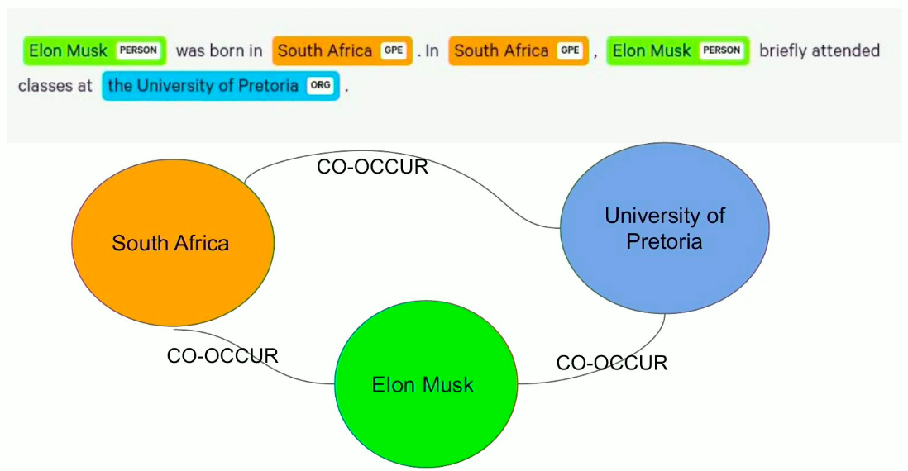
Co-Occurrence Graphs
Co-occurrence networks for graphs are basically when you’re inferring relationships between a pair of entities based on their presence within a specified unit of text.

Slide 25
For example, we could say that if two entities co-occur or are present in the same sentence, that they are somehow related. We don’t really know how, but we know that they are somehow related because they appeared in the same sentence. Here you can also see that the coreference resolution is quite important; if we split the specified unit of text into a sentence and don’t use coreference resolution here in the second sentence, we’ll have a single entity with two pronouns. That would lead to our information extraction not being full, but we can avoid this by using coreference resolution.

Slide 26
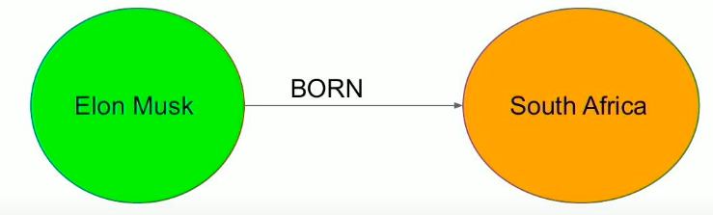
Step 3: Relationship Extraction
What if we want to extract semantic relationships from text and don’t just want a generic relationship between them, where they all just co-occur? We want to define a semantic type to the relationship between a pair of entities.

Slide 27
The relationships are usually categorized for the readability of your narrative. There are two different approaches to categorizing relationships between pairs of entities. One approach is the rule based relationship extraction, where you use grammatical dependencies of the texts to extract relationships. The second approach is to train an NLP model to extract relationships between a pair of entities. First, we’ll take a look at rule-based relationship extraction.

Slide 28
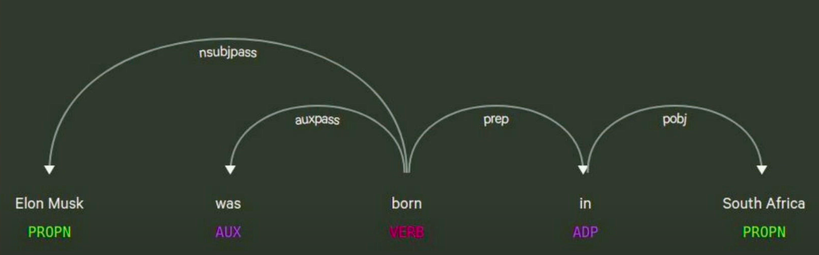
Rule-Based Relationship Extraction
I’ve used spacing to visualize the grammatical dependencies of the sentence, Elon Musk was born in South Africa. RDF (Resource Description Framework) graphs use a data selection tree post, where they have a subject, verb, predicate, and object. The predicate is the relationship between the two entities.

Slide 29
As you can see in the image above, we have the verb in the middle, and the subject is Elon Musk. The object is South Africa. We can infer that Elon Musk was born in South Africa instead of just having a co-occurrence generic relationship between them. There are some pros and cons to this. You’re not really doing any semantic categorization of your relationships because you’re just taking the verb, which has the time component, meaning it could be present, future, or past tense. This may or may not be a good idea to have in a knowledge graph . There could be synonyms of verbs that have different relationship types with similar, identical semantic values.
My suggestion would be that if you use the rule-based relation extraction, then you also should do some post-processing of the verbs and try to fill them into some semantic categories. This way you don’t end up with so many relationship types. For example, you could use synonyms to drop some verbs into the same category.

Slide 30
NLP Model Based Relationship Extraction
The other approach that applies to relation extraction is using an NLP model again. You have to train your NLP model to infer the relations between pairs of entities, and the types of relationships that I would infer depend on the training data that is used to train the model. For example, if you’re analyzing news articles, you want to have a different model than if you are analyzing biomedical articles. opens in new tabTACRED is a dataset made available by Stanford, and then there is the Wiki80 dataset, which we’ll now take a closer look at.

Slide 31
Training Your NLP Model Using Wiki80
The Wiki80 training dataset contains 80 different relationship packs. The same semantic categories of relationships used on Wikipedia are also used in the training data. For me, it’s really interesting to see that if you use Wikipedia as the target database for entity linking, you’re using the Wiki80 training dataset. You can further train the relationships that fall to the Wikipedia ontology between pairs of entities. If you do this, you’re actually constructing a long mini Wikipedia-like knowledge graph. I find that quite awesome!

Slide 32
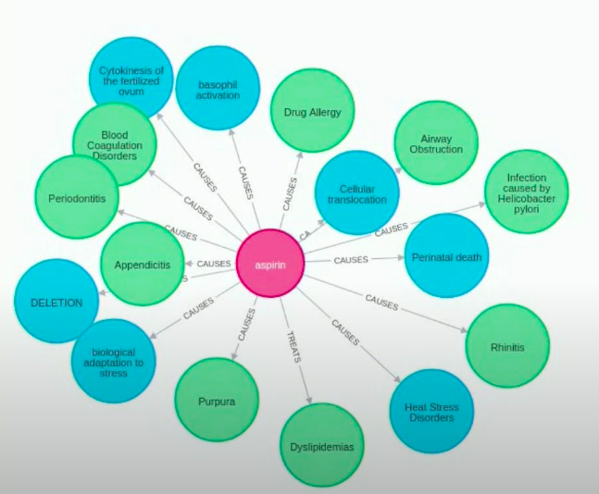
Real World Example: Drug Repurposing

Slide 33
Now we’ll look at a real-world example of an information extraction pipeline for drug repurposing. You need a knowledge graph with medical concepts, so you can have many types of nodes. These node types could be genes, drugs, diseases, or other types of nodes. There are many types of relationships between these medical concepts, as shown above: TREATS, CAUSES, PREDISPOSES, and others.

Slide 34
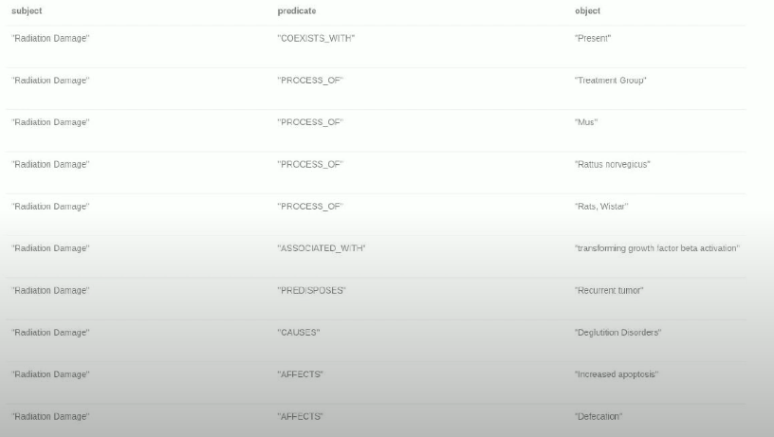

Slide 35
Then you can make link predictions for the TREATS relationship, which would predict new uses for a drug. This is drug repurposing. You use text input into the information extraction pipeline, such as medical journals, including the opens in new tabPubMed dataset, or medical papers, and then perform a named entity linking. Like Wikipedia, you could use online medical databases, including opens in new tabENSEMBL, to map genes to the corresponding IDs in the target database. There is also opens in new tabCHEBI for chemical substances. Basically, you do the name entity linking and extract your biomedical concepts. To extract relationships between those entities is challenging since there are no existing training datasets available, but there is a semantic opens in new tabMEDLINE Database where a group of scientists and doctors have a base relation extraction for data available on their website. You could also use that to try extracting relations with your own NLP model.

Slide 36
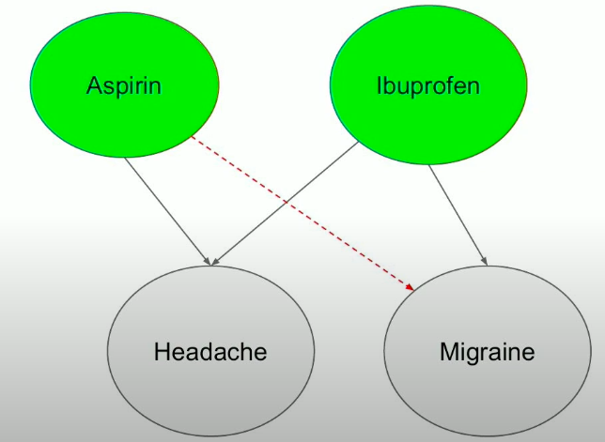
Step 4: Knowledge Graph
Now that you have biomedical concepts as entities and the relationships between them, you create a opens in new tab knowledge graph and try to predict new use cases for existing drugs.

Slide 37
Here, I’ve created a simple example where we have drugs and diseases. The real-world example is of course much more complicated because you could also have genes, meaning a headache could be associated with the same genes for migraines, and then there are relationships between genes. It quickly gets complicated, but I’ll just give you a simple idea for drug repurposing. When you try to predict new links, what you do is length reduction, or what is called a knowledge graph completion, since it’s quite different if this new predicted relationship is TREATS or CAUSES.

Slide 38
GraphRAG
https://github.com/stephenc222/example-graphrag/blob/main/app.py

Slide 39
GraphRAG is an advanced version of retrieval-augmented generation (RAG) that incorporates graph-structured data, such as knowledge graphs (KGs).¹ Unlike baseline RAG systems that rely on vector search to retrieve semantically similar text, GraphRAG leverages the relational structure of graphs to retrieve and process information based on domain-specific queries.
GraphRAG was introduced by Microsoft research in 2024 to address the limitations of large language models (LLMs).² Traditional LLMs often struggle with complex workflows, especially in reasoning private or structured data, because they lack the ability to understand relationships between entities. GraphRAG solves this issue by using graph databases to model these relationships, enabling it to handle complex queries, retrieve contextual information and improve accuracy in generative AI (gen AI) applications.

Slide 40
How does GraphRAG work?
Retrieval-augmented generation (RAG) is a technique that retrieves relevant information by using similarity search from vector databases, external knowledge sources and internal knowledge bases. It then combines this retrieved information with LLMs to generate accurate and context-aware outputs. While traditional RAG applications enhance the functionality of LLMs in generative AI applications, it lacks the ability to capture complex data relationships in data. It struggles to perform tasks such as multihop reasoning (combining information from multiple sources to derive answers through logical connections and indirect inferences), relational context and understanding hierarchical data.
GraphRAG overcomes this issue by incorporating graph-structured data, which organizes information as a network of nodes (entities like people or places), edges (relationships between those entities) and labels (attributes that define the category of a node and edge). For example, a knowledge graph might represent "Albert Einstein—developed—the theory of relativity." as a graph-structured pieces of information, making it easier for GraphRAG to retrieve and process this information. In this example, the nodes are ‘Albert Einstein’ and ‘theory of relativity’, and the edge is ‘developed’.

Slide 41
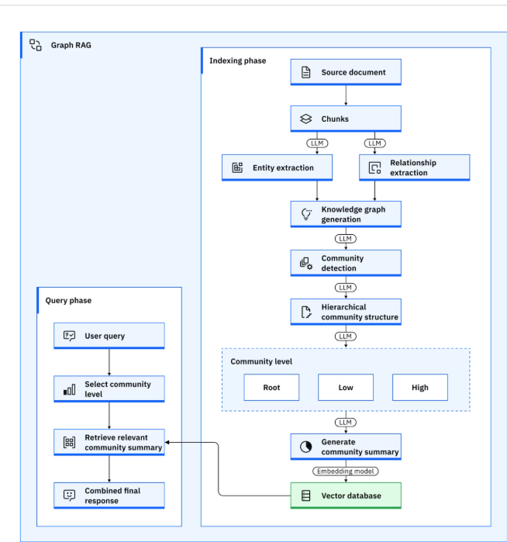

Slide 42
Components of GraphRAG
GraphRAG works through four main components:
Query processor
Retriever
Organizer
Generator

Slide 43
Query processor
The user’s query is preprocessed to identify key entities and relationships relevant to the graph structure. Techniques such as named-entity recognition (NER) and relational extraction from machine learning are used to map the query to nodes and edges within the graph. For example, a query like "Who developed the theory of relativity?" identifies "Albert Einstein" as a node and "developed " as the relationship to be searched in the graph. Tools like Cypher, a graph query language, are used to fetch domain-specific data from knowledge graphs.

Slide 44
Retriever
The retriever locates and extracts relevant content from external graph data sources based on the processed query. Unlike traditional RAG systems that rely on vector embeddings for text or images, GraphRAG retrievers handle graph-structured data by leveraging both semantic and structural signals. They use techniques such as graph traversal algorithms (methods like breadth-first search (BFS) or depth-first search (DFS) that explore the graph to locate relevant nodes and edges). Additional techniques include graph neural networks (GNNs) (advanced AI models that learn the structure of graphs to retrieve data effectively), adaptive retrieval (dynamically adjusts how much of the graph to search, reducing irrelevant information or noise) and embedding models. For the query "Who developed the theory of relativity?", the retriever locates the node "theory of relativity" in the graph and follows the "developed by" relationship to find "Albert Einstein."

Slide 45
Organizer
The retrieved graph data is refined to remove irrelevant or noisy information through techniques like graph pruning, reranking and augmentation. The organizer helps ensure the retrieved graph is clean, compact and ready for processing while preserving critical contextual information. For the query "Who developed the theory of relativity?" the organizer refines the retrieved graph data by removing irrelevant nodes and edges, helping ensure only the relevant relationship, "Albert Einstein—developed—theory of relativity," is retained.

Slide 46
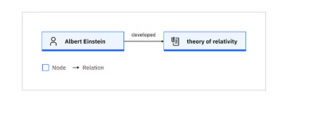
Generator
The cleaned graph data is then used to produce the final output. This can involve generating text-based answers using LLMs or creating new graph structures for scientific tasks, such as molecule design or knowledge graph expansion. For the query "Who developed the theory of relativity?", GraphRAG retrieves "Albert Einstein" from the graph and generates the answer: "Albert Einstein developed the theory of relativity." Generative AI techniques are used to synthesize the final response.

Slide 47
Applications of GraphRAG
GraphRAG is transformative across industries, combining graph-based reasoning, vector search and generative AI to handle domain-specific tasks that demand deep contextual information. Below, we explore some of the key applications of GraphRAG:
Query-focused text summarization (QFS)
Personalized recommendations
Decision support
Fraud detection and prevention
Knowledge management and retrieval

Slide 48
Query-focused text summarization (QFS)
GraphRAG can be used for query-focused text summarization. It focuses on answering specific user queries by retrieving and synthesizing information from a graph-structured representation of the text. A study demonstrated GraphRAG’s effectiveness in answering global, exploratory questions over large datasets, such as podcast transcripts and news articles.³ It outperformed traditional vector-based RAG systems in tasks requiring comprehensive and diverse insights. For example, GraphRAG was tested on a podcast dataset (~1M tokens) featuring conversations with tech leaders and a news dataset (~1.7M tokens) covering health, business and technology topics. Questions included “How do tech leaders view privacy laws?” and “What are the key public health priorities?”
GraphRAG processes these datasets by building a knowledge graph with entities (for example, “privacy laws”) and relationships (for example, “impact on tech”), organizing them into hierarchical communities (group of connected nodes organizing high-level topics to specific sub-topics). Pregenerated community summaries allow the system to retrieve and combine relevant insights efficiently. Compared to traditional RAG, GraphRAG achieved higher comprehensiveness (72–83%) and diversity (62–82%) in generated answers while requiring up to 97% fewer tokens for root-level summaries. This ability makes GraphRAG an ideal tool for sense-making tasks in domains like journalism, education and research.

Slide 49
Personalized recommendations
In domains like e-commerce and entertainment, GraphRAG enables chatbots and recommendation engines to deliver personalized experiences. For example, in e-commerce, the past interactions between users and products can form a graph. GraphRAG helps manage the growing volume of user interaction data by extracting key subgraphs that reveal user preferences and behaviors. Research has demonstrated that using multiple retrievers to extract relevant subgraphs enhances user action prediction, while retrieving subgraphs of similar past issues improves the quality of customer service question-answering systems.⁴

Slide 50
Decision support
In healthcare, GraphRAG assists doctors in diagnosing patients with complex symptoms by analyzing relationships between diseases, symptoms and treatments within a graph database. It retrieves relevant medical studies, case reports and drug information to suggest possible diagnoses, highlight effective treatment options and even warn of potential drug interactions. This capability allows healthcare professionals to make more informed decisions, reduce diagnostic errors and provide personalized care to patients.
For example, a recent study introduced MedGraphRAG, a framework designed for medical applications.⁵ It organizes medical data into three levels: private user data (for example, medical reports), recent peer-reviewed medical literature and foundational medical dictionaries, helping ensure accuracy, traceability and relevance. Using a hierarchical graph structure and a "U-retrieve" strategy, it efficiently retrieves and synthesizes information for user queries, improving the performance of LLMs by generating reliable, evidence-based responses with source citations. This framework demonstrates the potential for secure, transparent and efficient clinical workflows, aiding healthcare professionals with grounded, actionable insights.

Slide 51
Fraud detection and prevention
GraphRAG identifies unusual patterns that deviate from expected behavior. For example, in financial services, it can detect suspicious transaction patterns to prevent fraud or uncover cross-selling opportunities by analyzing customer behavior. By connecting multiple small transactions across accounts, GraphRAG can reveal larger fraudulent schemes, helping banks enhance risk management and provide more personalized services.

Slide 52
Knowledge management and retrieval
GraphRAG can enhance knowledge management by organizing and retrieving documents in a way that makes knowledge more accessible and tailored to specific queries. It analyzes the context and relationships between various documents and helps extract the most relevant information quickly and effectively. For example, one prominent use case of GraphRAG is in law firms, where it excels at managing vast collections of legal documents. By analyzing the relationships and context within thousands of legal documents, GraphRAG can efficiently retrieve relevant case precedents or legal references, streamlining research workflows and significantly improving accuracy.

Slide 53
Challenges of GraphRAG
GraphRAG systems present challenges such as managing complex data relationships, helping ensure efficient retrieval and integrating with language models. These challenges can be addressed through careful graph schema design, optimized query strategies and leveraging robust tools. The primary challenges associated with GraphRAG are:
Scalability
Streamlining component integration
Reliability
Privacy and safety
Explainability

Slide 54
Frameworks for building a GraphRAG system
GraphRAG systems can be implemented by using various tools and frameworks, including open source options, to support document processing, knowledge graph creation, semantic search and LLM integration. Popular tools include LangChain, LlamaIndex, Langflow, AstraDB from IBM® watsonx.data® and OpenAI, with additional resources and tutorials available on platforms such as GitHub.
These tools work together to enable semantic search by using vector embeddings, metadata handling for transparency and context-aware response generation. LLMs including OpenAI GPT models, integrated through APIs, help produce accurate and relevant answers based on retrieved graph data.
GraphRAG is a big step forward from traditional RAG systems, which are limited by linear retrieval methods. It combines the power of knowledge graphs, semantic search and advanced language models. As industries demand deeper understanding and interconnected insights, GraphRAG is set to become a key technology. It will enable smarter, more dynamic and highly adaptive information systems in the future.

Slide 55
graph_maker_example.ipynb
https://towardsdatascience.com/text-to-knowledge-graph-made-easy-with-graph-maker-f3f890c0dbe8/?source=post_page-----19822c0c0477---------------------------------------

Slide 56
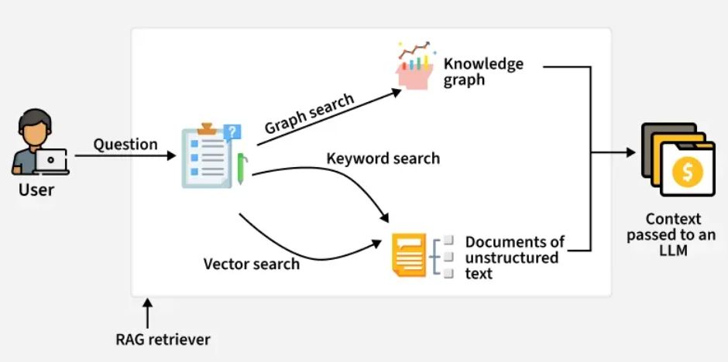
Knowledge Graph

Slide 57
Thank You

